Slide 1



Functional Roles of
Migratory Waterbirds
Josh Nightingale
Universidade Federale do Rio Grande do Sul
& Erasmus Mundus
International Master in Applied Ecology

Slide 2
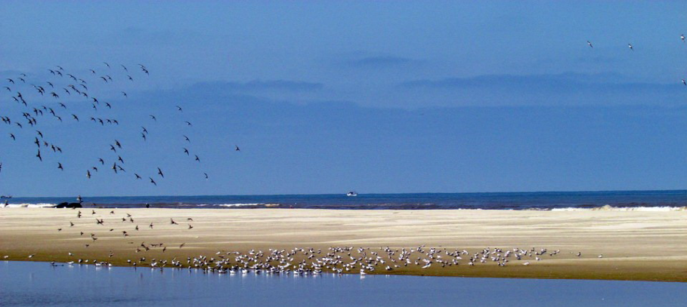
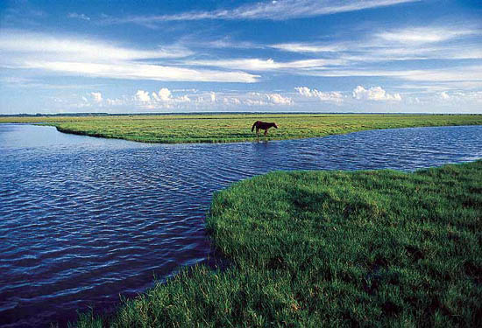
Questions
Community assembly in same environments from different species pools
Is there evidence of consistency?
i.e., environmental determinism

Slide 3
Questions
Functional equivalence of summer and winter migrants?
Functional roles of migratory vs resident species?
Differences between habitats in functions supported?

Slide 4
Approach
Functional roles of migratory vs resident species?
PCoA scores from Gower distance matrix
Compare between migrants and residents
Difference between pairs of migrants vs. random pairs

Slide 5
Approach
Functional equivalence of summer and winter migrants?
Hierarchical clustering of species and trait data (using Gower distance)
Variance partitioning of ß-variation

Slide 6
Predictions
Functional equivalence of summer and winter migrants?
Hierarchical clustering of species and trait data (using Gower distance)
Species data clusters within seasons
Functional data within habitats
Variance partitioning of ß-variation
Species data varies more by seasons
Functional data varies more by habitat

Slide 7
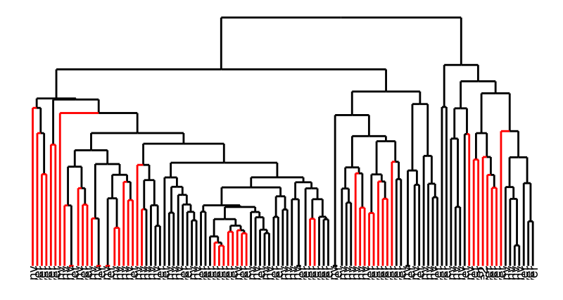
Species data
By season

Slide 8
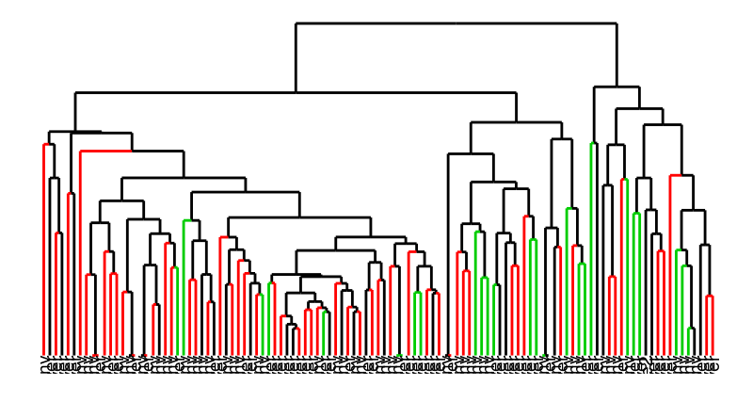
Species data
By habitat

Slide 9
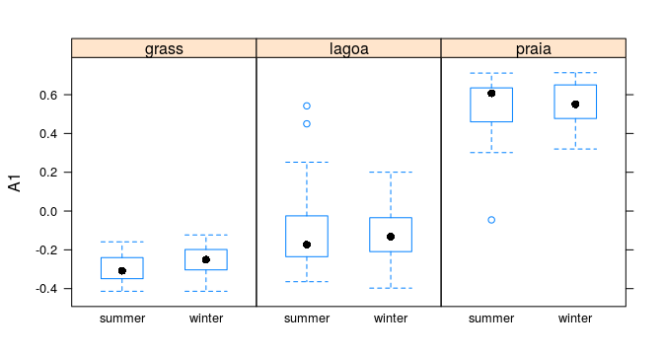
Species data
Presence/absence

Slide 10
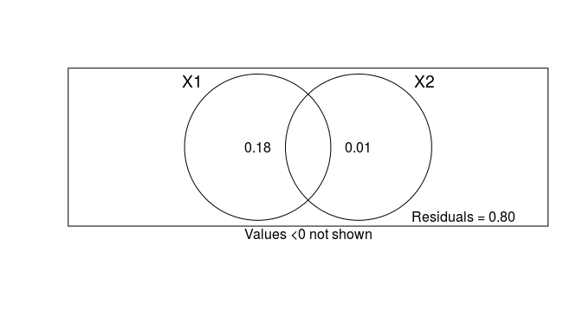
Species data
habitat
season
Log-transformed

Slide 11
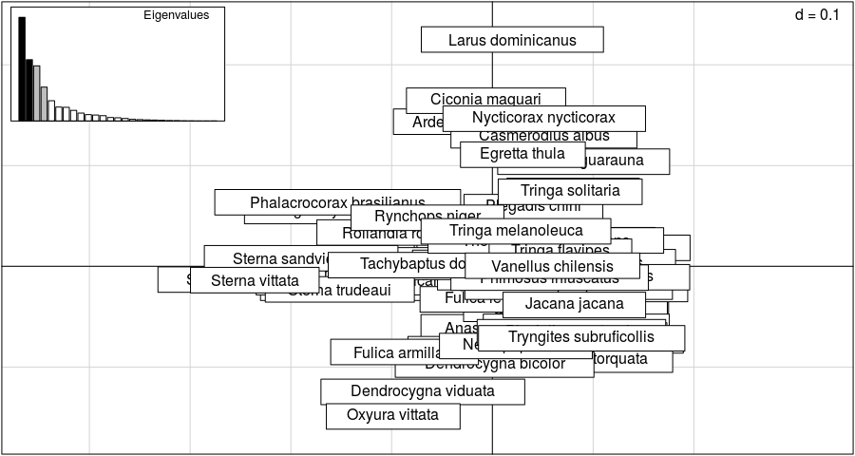
Functional variation

Slide 12
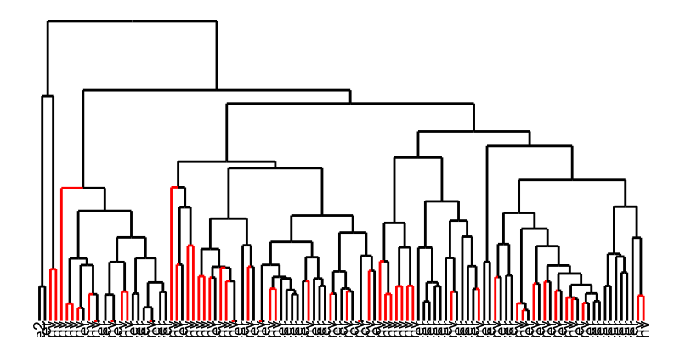
Functional data
By season

Slide 13
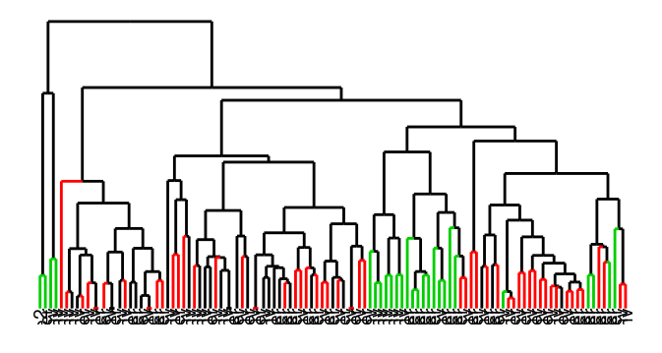
Functional data
By habitat

Slide 14
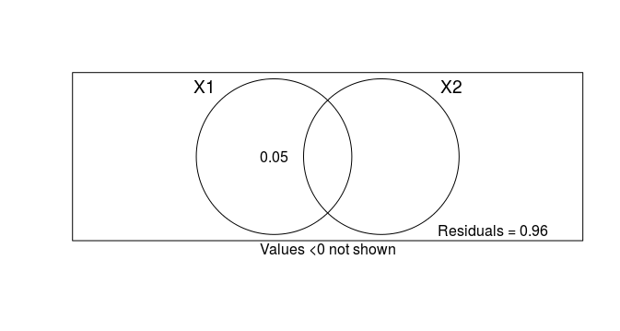
Functional data
habitat
season

Slide 15
Approach
Differences between habitats in functions supported?
Comparison of CWMs

Slide 16
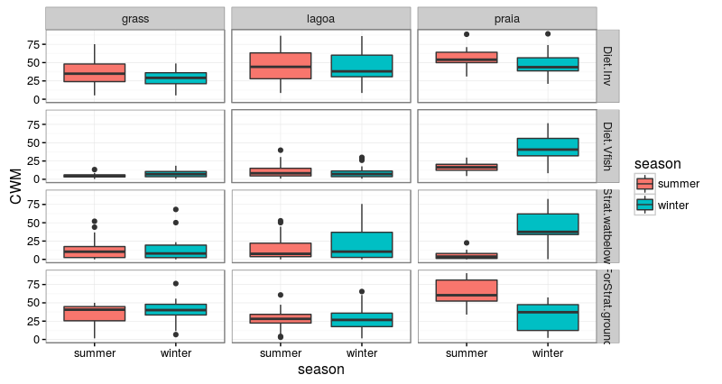

Slide 17
“Conclusions”
Signals not very clear visually
Need an analytical approach
Species clearly cluster within habitats more than seasons
Migrants a small % of community
Some evidence of seasonal functional changes

Slide 18
TODO
Normalize species data within sites?
Or use presence/absence?
Analyse functional groups of species separately
Seasonality of resident species?
Temporal trends? (2005-2016)

